Slide 1
BOME mapping installation guide for all Pioneer DDJ controllers
Installation video: https://youtu.be/MbGP_ECnWiQ
NOTE 1: This guide covers all DDJ controllers. The only difference is the Aliases (page 10) and Output (page 28). The Annexes have specific pictures for specific DDJs.
NOTE 2: This mapping requires the third-party BOME midi translator. It has a free trial for you to test this mapping before buying a license.
NOTE 3: Issues? See the FAQ in a pdf, the “gotchas” on page 34, and reconfirm if you missed a step of this guide.

Slide 2
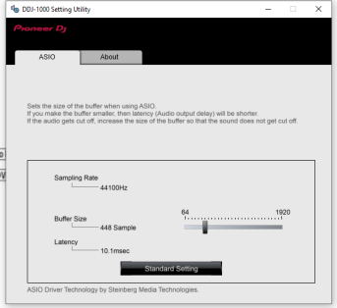
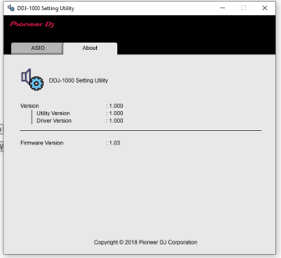
Step #0
CONFIRM THAT REKORDBOX PERFORMANCE MODE WORKS PROPERLY IN YOUR SYSTEM!!
Driver Download: https://www.pioneerdj.com/en/support/software/controller/ddj-1000/#drivers
Firmware download: https://www.pioneerdj.com/en/support/software/controller/ddj-1000/#firmware-update
Rekordbox DJ download: https://rekordbox.com/en/
VirtualDJ Instructions (for reference): https://www.virtualdj.com/manuals/hardware/pioneer/ddj1000/installation.html

Slide 3
Step #1
BOME TRIAL: INSTALLATION do not skip any step!

Slide 4
BOME SOFTWARE INSTALLATION:
Download and install the BOME trial from https://www.bome.com/products/miditranslator#downloads
MAC-OS SECURITY ENABLE (see page 40 of the BOME manual):
macOS 10.9 and later:
System Preferences → Security & Privacy → Privacy → Accessibility -> Add “BOME”
macOS 10.8 and earlier:
System Preferences → Universal Access → check 'access for assistive devices‘
More info: https://www.maketecheasier.com/macos-security-privacy-permissions/

Slide 5
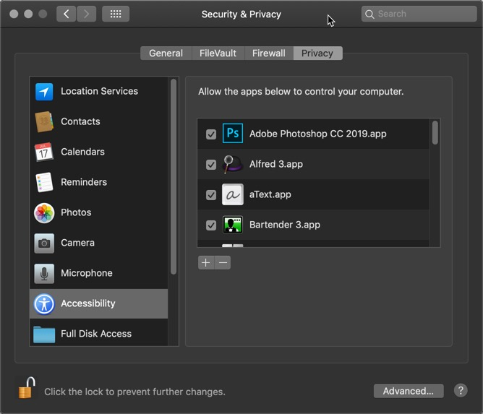
macOS security:

Slide 6
Step #2
MAP FOR BOME: INSTALLATION do not skip any step!

Slide 7
PRELIMINARIES:
Stop Rekordbox
Stop Traktor
Expand all files in the zip file
Connect the USB cable
Turn on your DDJ
INSTALLING BOME MAPPING:
Open BOME. DO NOT RUN TRAKTOR!
Settings: Import the settings file
Method: menu View; settings; export/import; import; select BMTS file
Mapping: load the mapping file
Method: Click menu File; Open; select BMTP file
Do not mix up the Settings file with the Mapping file!
Beware!

Slide 8
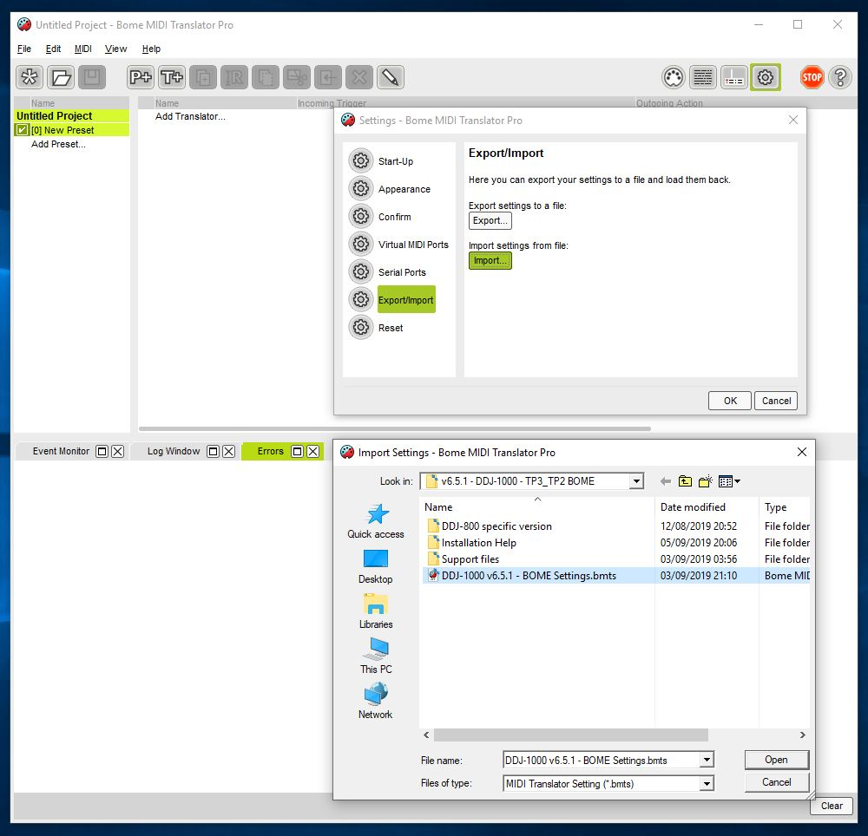
BOME: import settings file (BMTS file)
(Example for DDJ-1000; other DDJ are similar. See annexes for details)

Slide 9
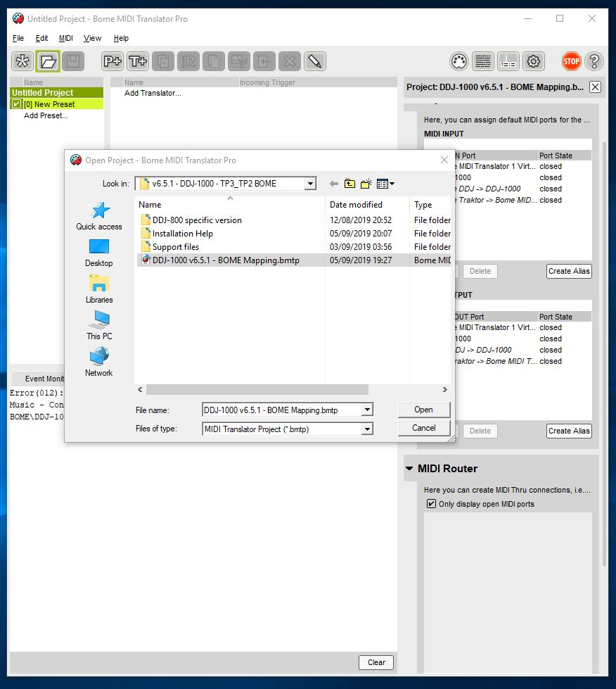
BOME: import mapping file (BMTP file)
(Example for DDJ-1000; other DDJ are similar. See annexes for details)

Slide 10
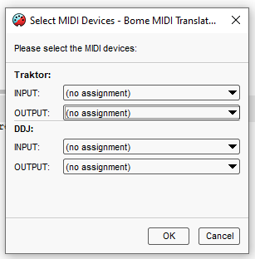
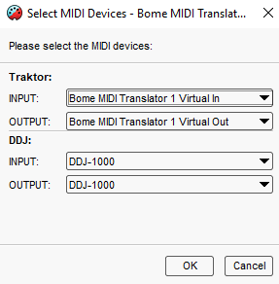
BOME: Aliases
Replace this with your DDJ-SX2/SZ/SRT etc!

Slide 11
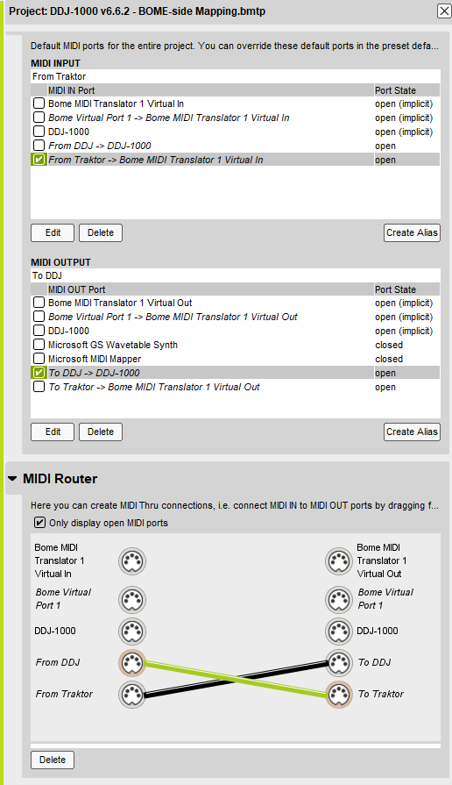
BOME: Devices
Confirm the devices are OPEN!
Ensure ONLY these 2x options are checked:
- “From Traktor” -> device 1 in OPEN - “to DDJ” -> DDJ-1000 OPEN
Confirm it looks EXACTLY like on the picture
Confirm this “cross” on EXACTLY these aliases
(Example for DDJ-1000; other DDJ are similar. See annexes for details)

Slide 12
Step #3
MAP FOR BOM: VERIFICATION
do not skip any step!

Slide 13
BOME VERIFICATION STEPS:
Confirm the “Bome MIDI Translator 1” device is created (longformat)
Method: menu View ; settings ; virtual midi ports ; 1 port; long port names
Confirm the 4x midi ports were opened correctly
Method: Click log window; check log
Confirm that the Controller talks to BOME
Method: Click log window; click “MIDI-IN/OUT”; Press any button on the controller; confirm they appear in the log file; unclick “MIDI-IN/OUT”
Confirm that the BOME clock is running
Method: Click log window; click “rules”; see a lot of messages appearing
unclick “rules” to stop the logging
Minimize BOME to keep it running

Slide 14
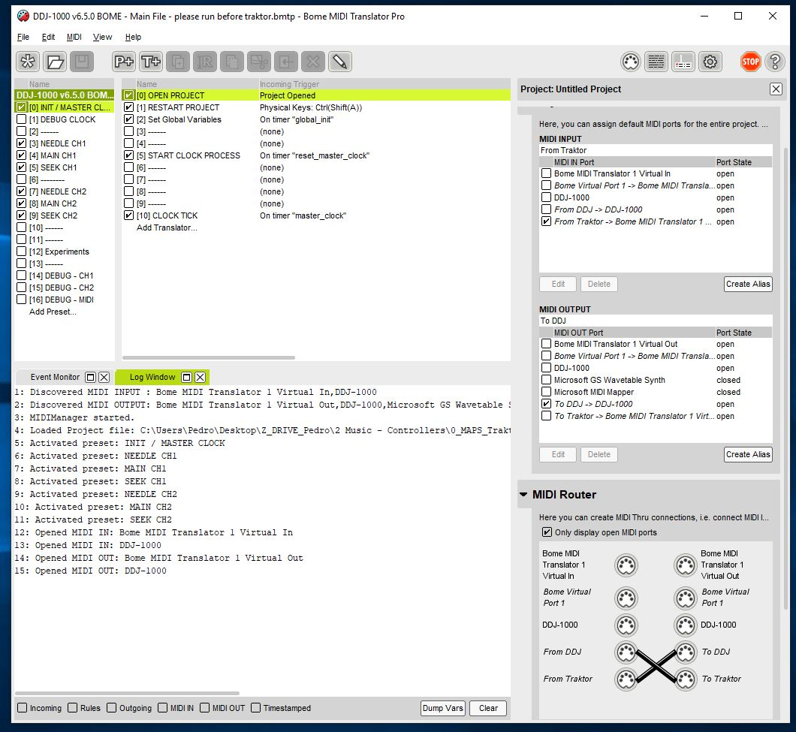
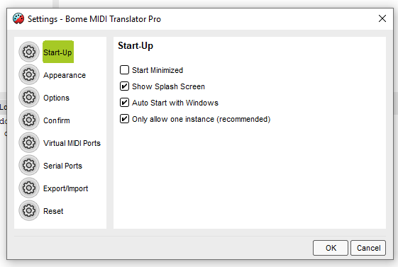
BOME settings: auto start with windows
Auto start with Windows!

Slide 15
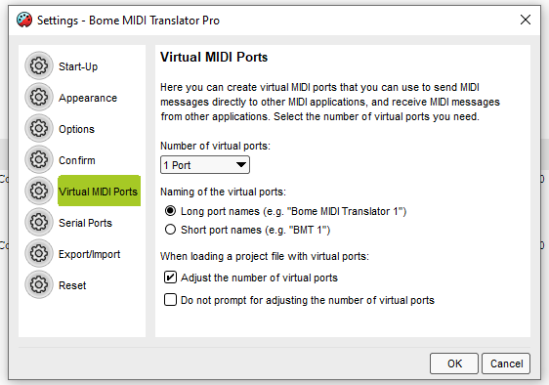
BOME settings: long port name device
Long port names!

Slide 16
BOME: Correct startup log
Do not change this! Default is ONLY - “From Traktor” OPEN - “to DDJ” OPEN confirm devices are OPEN!
4x messages here!
Do not change this “cross”!
(Example for DDJ-1000; other DDJ are similar. See annexes for details)

Slide 17
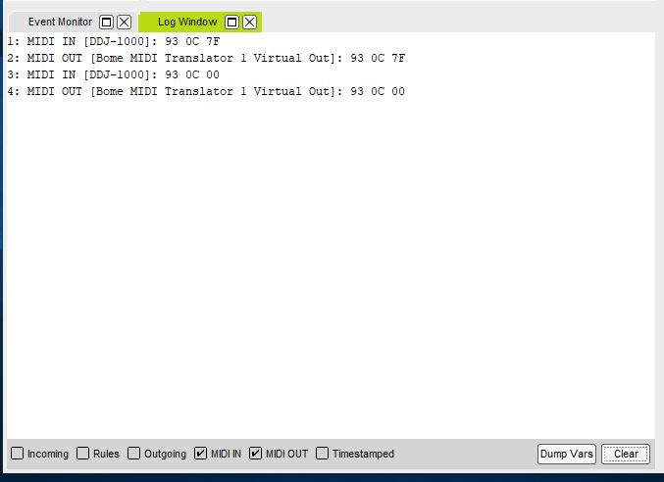
BOME: confirm DDJ talks to BOME
Pressing and releasing any button generates 4 log lines. This is always in the DDJ->BMT1 direction
Activate MIDI debug here
(Example for DDJ-1000; other DDJ are similar. See annexes for details)

Slide 18
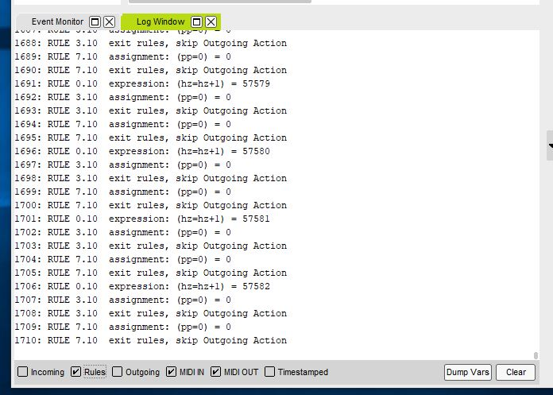
BOME: confirm internal clock
HZ goes up one by one continuously
Activate rules debug here
(Please click “rules” again to stop the logging)
Tip!

Slide 19
Step #4
MAP FOR TRAKTOR: INSTALLATION do not skip any step!

Slide 20
CREATE A BACKUP:
Note: the mapping replaces a lot of your settings. In any cases, Traktor always makes automatic backups in “Root_Dir\Backup\Settings”
Open Traktor
Click Settings
Click big “export button” on lower left corner
Ensure all settings are clicked
Save the file
INSTALL TRAKTOR MAPPING:
Click Settings
Click big “import button” on lower left corner
Accept all checks; PLUS additionally click the “Audio device settings”
INSTALL TRAKTOR MAPPING (second time):
Repeat above process a second time. This is only to avoid a Traktor bug that gets the FX list wrong.
MAC-OS AUDIO OUTPUT ROUTING:
Set preferences / Output Routing / Internal to: 2 / 3 / 0 / 1
Extra click!

Slide 21
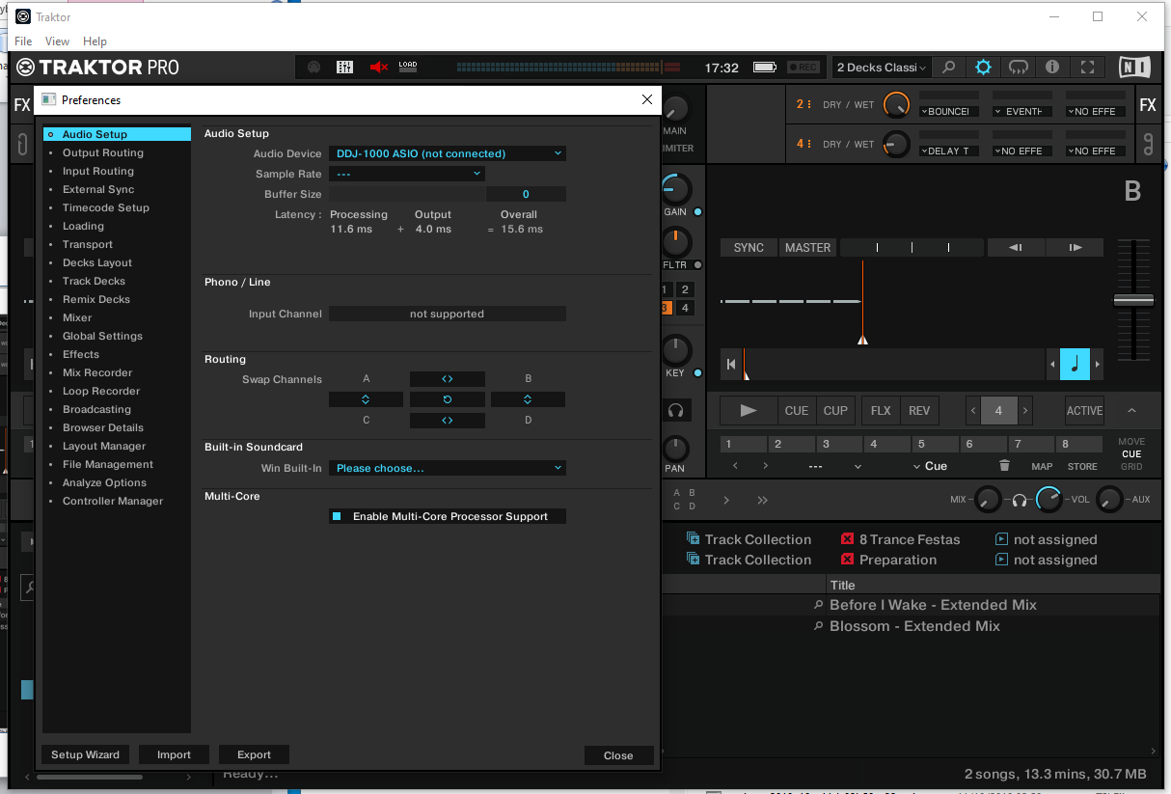
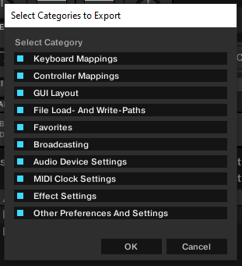
TRAKTOR: create backup of your settings
Backup everything!

Slide 22
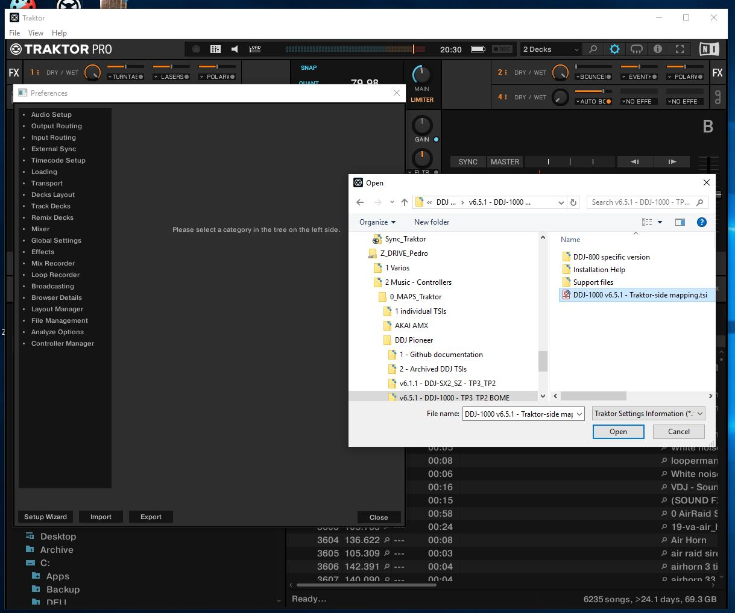
TRAKTOR: import mapping
(Example for DDJ-1000; other DDJ are similar. See annexes for details)

Slide 23
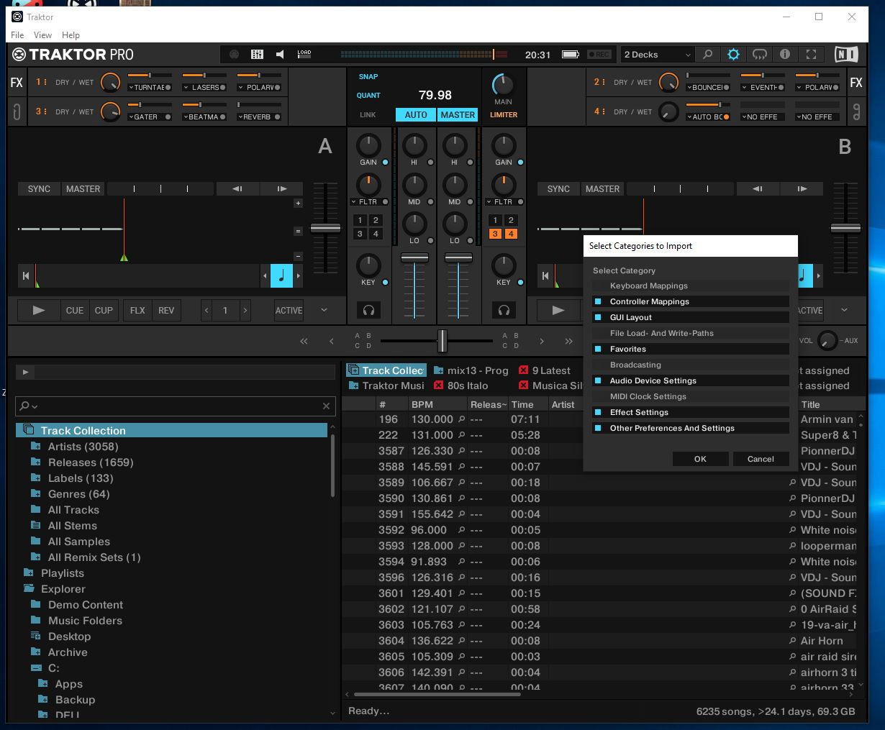
TRAKTOR: click audio device config
Please include this one as well
(Example for DDJ-1000; other DDJ are similar. See annexes for details)

Slide 24
TRAKTOR: import mapping (second time)
(Example for DDJ-1000; other DDJ are similar. See annexes for details)

Slide 25
Step #5
MAP FOR TRAKTOR: VERIFICATION do not skip any step!

Slide 26
TRAKTOR VERIFICATION:
Note: the Preferences window is now quite slow to open. This is another Traktor bug.
Confirm the audio device is “DDJ-1000 ASIO” / “DDJ-SZ ASIO” / etc
Method: Settings ; audio setup ; confirm audio device
Confirm the Output routing
Method: Settings ; output routing; confirm “internal”; confirm “3 / 4 / 1 / 2”
(see annexes for other DDJs case)
Confirm that all 6x pages have exactly “Bome Midi Translator1”
Method: Settings; controller manager; click each of the 6x pages one-by-one; check IN and OUT port
DO NOT CHANGE TO DDJ-1000 in the controller manager!!!
DO NOT FORGET TO CONFIRM ALL 6x PAGES!
Verify that sound is played
Method: Load a track; click Cue and play/pause repeatedly
Use shift+quantize to send a reset command to BOME
Verify that BOME sees all the messages
Method: open the bome window; click the “CUE” button; verify that the BOME log displays at least 8x log lines per human click
Beware #1!
Beware #2!

Slide 27
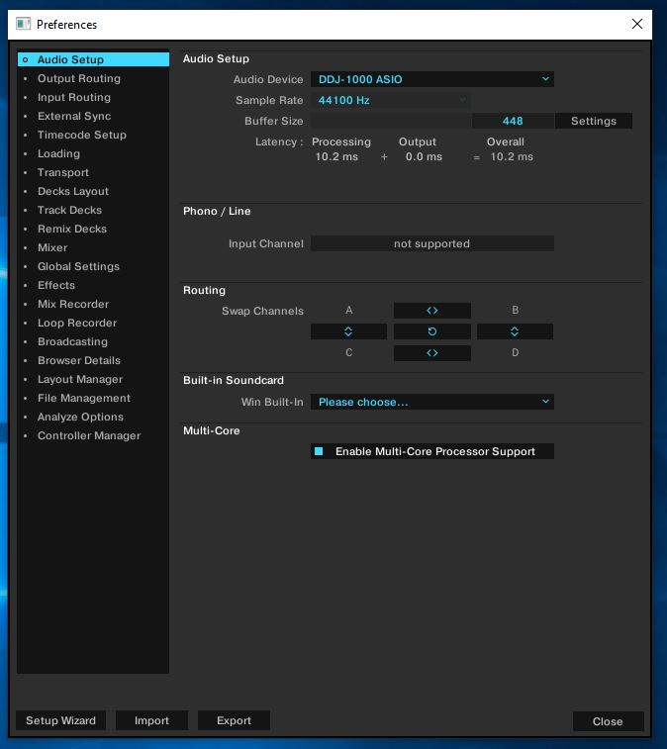
TRAKTOR: check audio device
(Example for DDJ-1000; other DDJ are similar. See annexes for details)

Slide 28
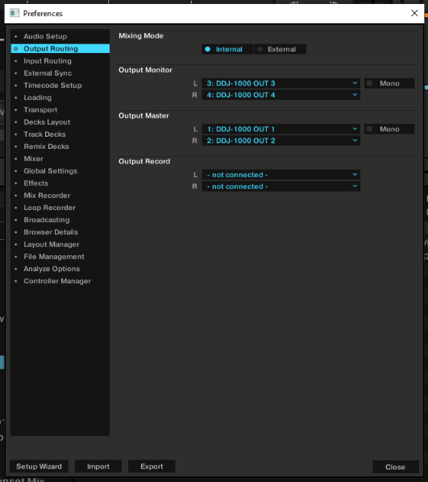
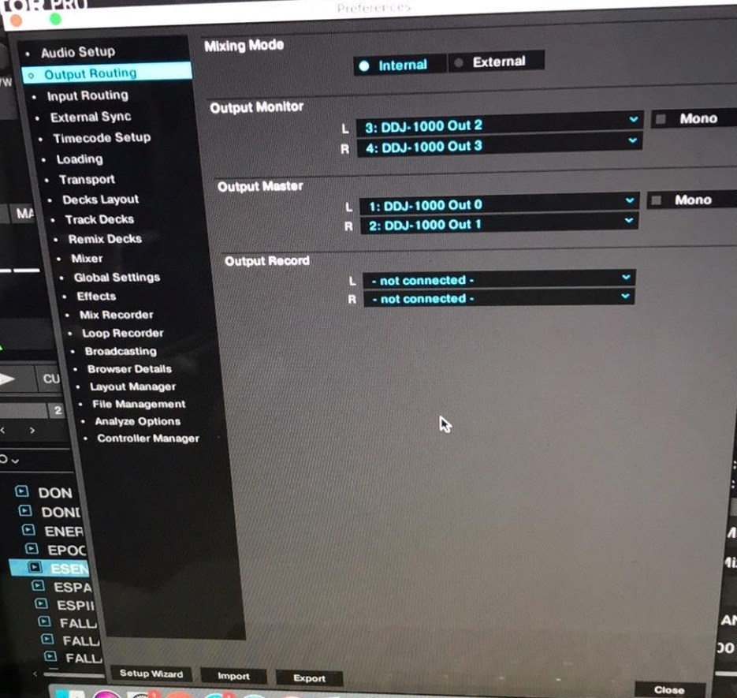
TRAKTOR: check output routing
Important: the below pictures is for DDJ-1000; the other DDJ are different if they are internal or external mode See annexes for specific pictures for your DDJ!
Windows: channels are 3 / 4 / 1 / 2
MacOS: channels are 2 / 3 / 0 / 1

Slide 29
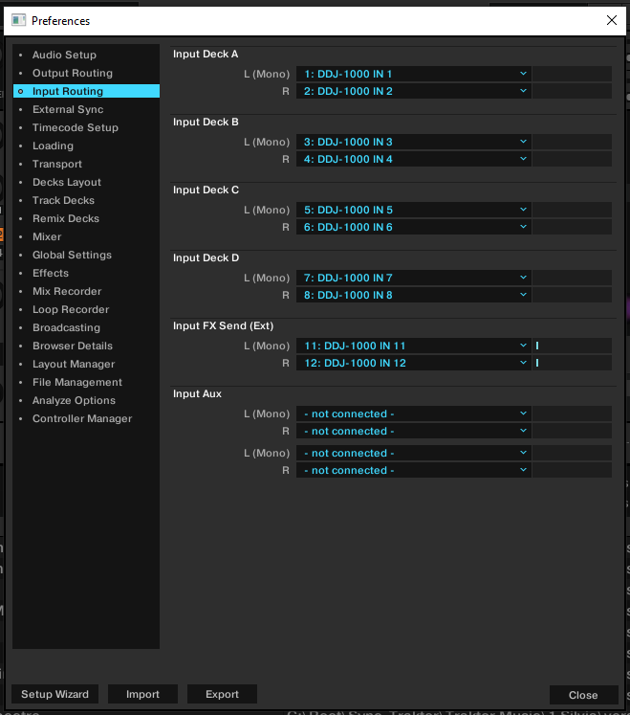
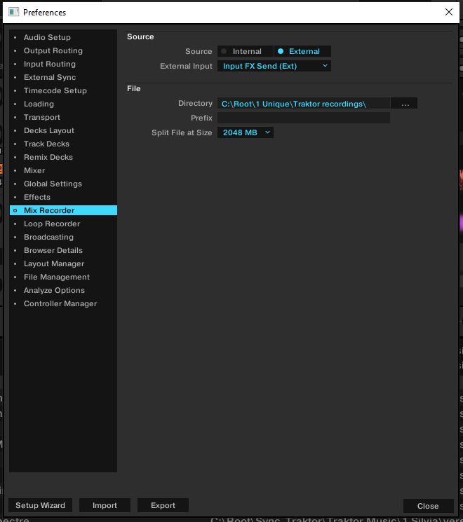
TRAKTOR: recording settings

Slide 30
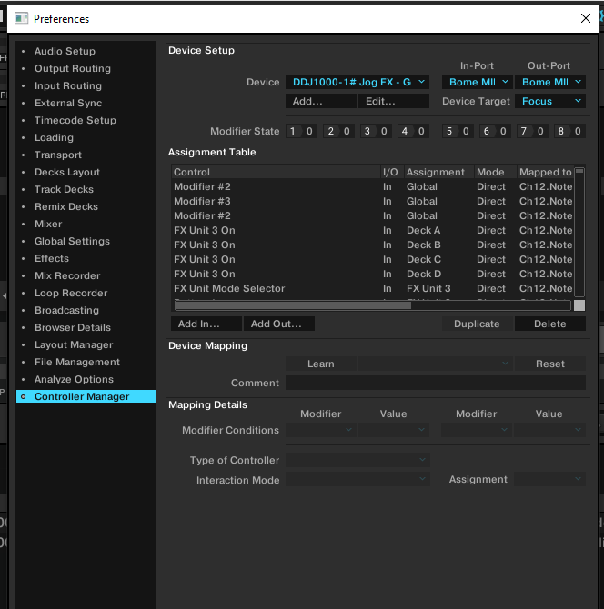
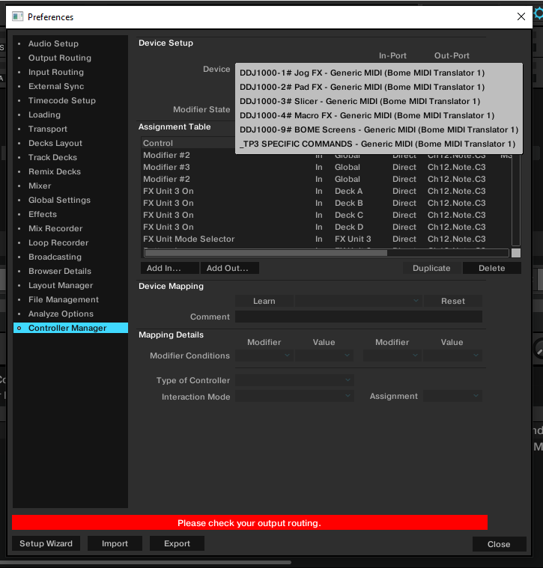
TRAKTOR: check MIDI device is long format
first click here
Both IN and OUT = Long format For ALL 6 PAGES!

Slide 31
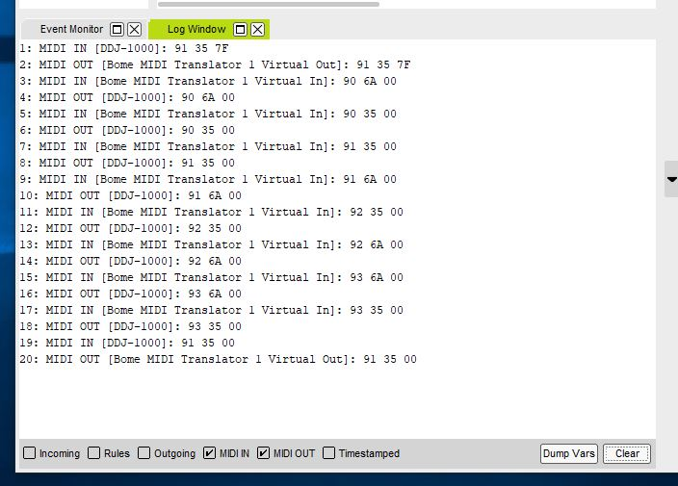
BOME: confirm bidirectional flow
Pressing and releasing any button generates at least 8x log lines. This is both in the DDJ->BMT1 direction and the BMT1->DDJ direction
Stop “rules” log

Slide 32
Step #6
PROPER START SEQUENCE

Slide 33
PROPER START-UP SEQUENCE IF YOU HAVE PROBLEMS:
Stop everything
Start Laptop
Start BOME
Start your DDJ
Start Traktor

Slide 34
IF ITS STILL NOT WORKING #1
Audio doesn’t work:
Re-confirm the DDJ-1000 is your audio device
Re-confirm output routing is 3/4/1/2 in windows and 2/3/0/1 in macOS
Re-confirm Rekordbox performance mode works.
Audio works - but MIDI doesn’t :
Re-confirm you have BOME in the macOS accessibly security
Re-confirm you have “Bome midi Translator 1” on all 6x pages in Traktor
MIDI works but jog screens / Leds doesn’t :
Reset the jog Screens using shift+quantize
Start components in this order: #1 Laptop #2 DDJ #3 BOME #4 Traktor

Slide 35
IF ITS STILL NOT WORKING #2
Make a HD video of the verification steps, INCLUDING THE BOME LOG.
Put your phone really close to the screen for me to read the small text!
Upload the video to https://wetransfer.com and send an email to pedro.estrela@gmail.com

Slide 36
ANNEXES

Slide 37
DDJ-1000: forced MIDI mode
In my experience there is no need to set the unit to forced MIDI mode.
If this is ever necessary, instructions are on page 26 of the DDJ-1000 manual:
no USB cable
power off DDJ
Press left play + left shift + turn on DDJ
left Slip Reverse:
Off = auto mode
ON = forced mode
Power off DDJ
Power ON DDJ
insert USB cable.

Slide 38
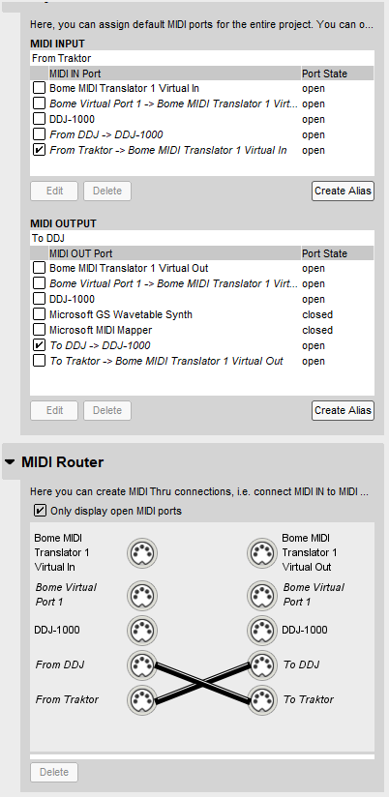
TRAKTOR DJ Software
AUDIO path
DDJ-1000
OS Driver
USB
TSI FILE (6 sub pages)
MIDI path
out port
DDJ-1000
in port
BMT1
From Traktor
To DDJ
To Traktor
BMTP file (7 presets)
From DDJ
BOME MIDI Translator
Settings
BMTS file

Slide 39
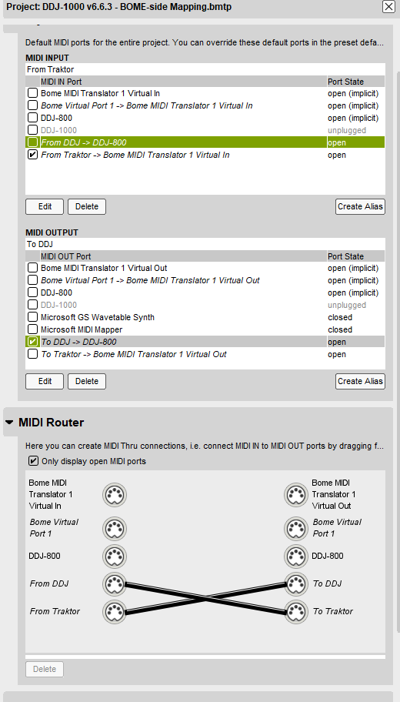
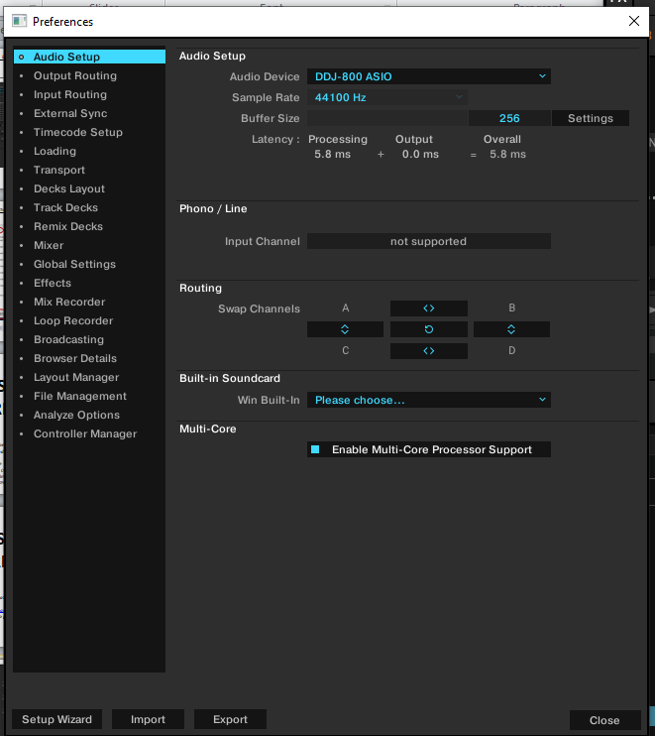
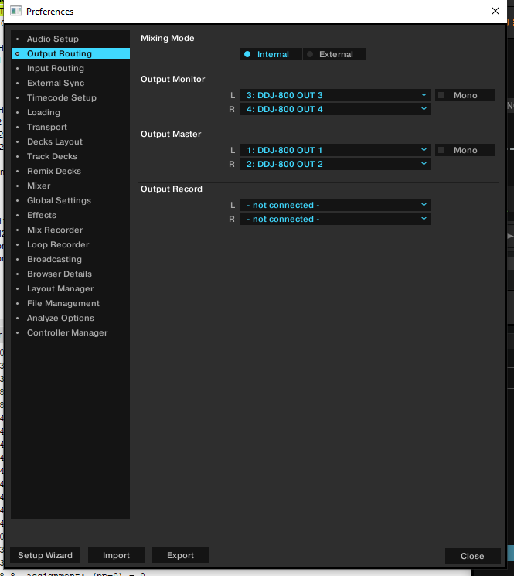
ANNEX: DDJ-800

Slide 40
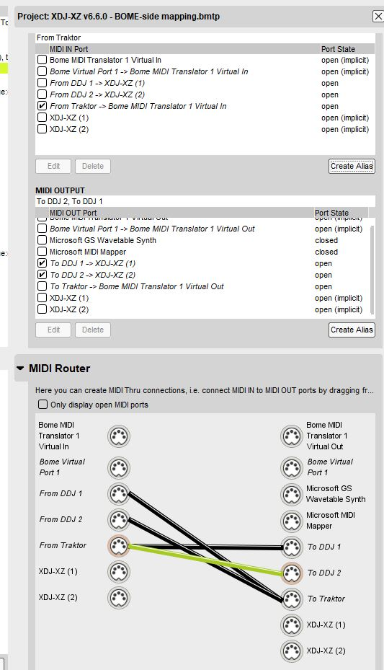
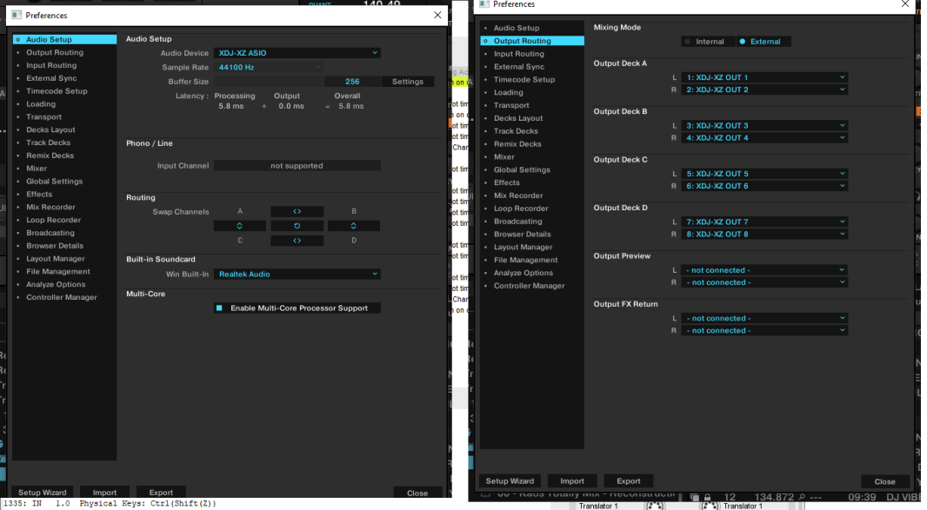
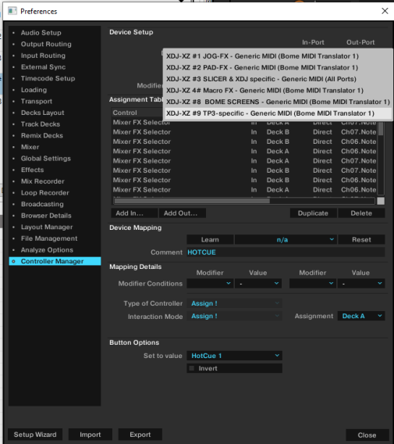
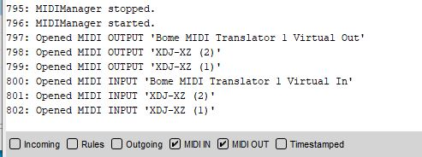
ANNEX: XDJ-XZ

Slide 41
ANNEX: DDJ-1000SRT
DDJ-1000SRT specific instructions for the Traktor mapping (for v6.1.X – not yet updated to V6.7.0 BOME)
Please use the specific TSI for the DDJ-1000SRT. This is the same mapping as the DDJ-SZ mapping, but with small customizations to make it work well on the SRT:
Jog screens are NOT supported. This is because they are not documented on the Pioneer MIDI map file. Please request this in https://serato.com/forum/discussion/1736390
Please put your jog weight to “heavy”
This will significantly improve scratching and jogFX
Audio device in external mode.
This means that ALL the pioneer effects (both colorFX and beatFX work for USB sources
See next slides for config
Please avoid VINYL OFF mode. The TSI disables jog touch in this case, but the jog loses resolution compared to VINYL ON mode
Beatjump buttons added. Please use shift+IN/OUT to configure the loop size (=jump size)
BeatFX ON/OFF is now for pioneer beatFX only
Automatic layout changing was removed

Slide 42
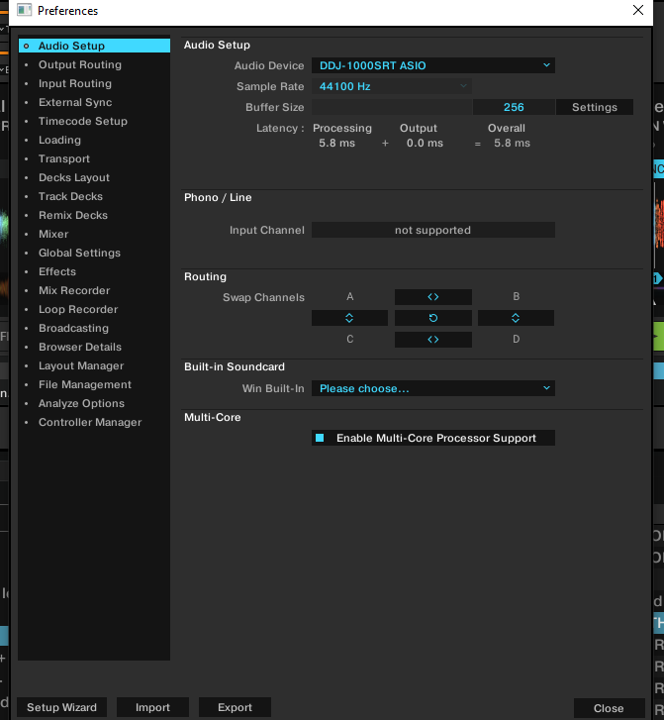
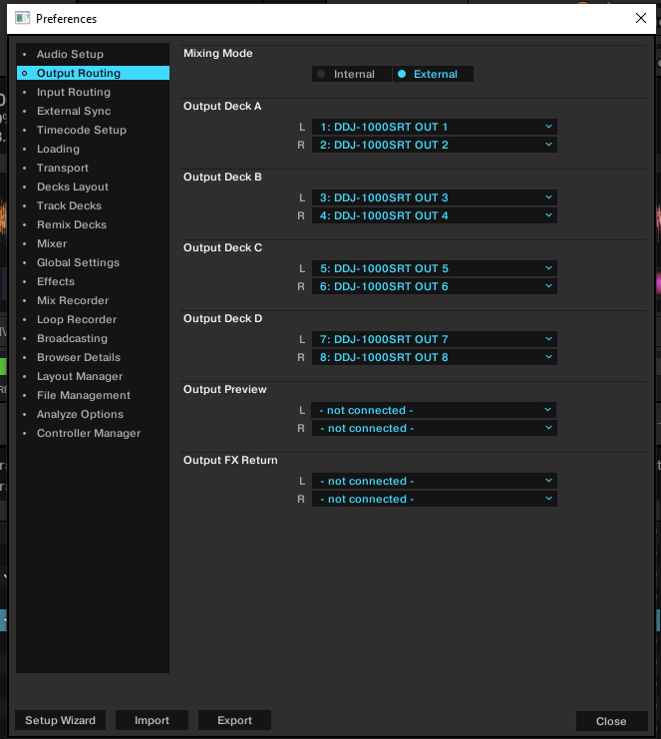
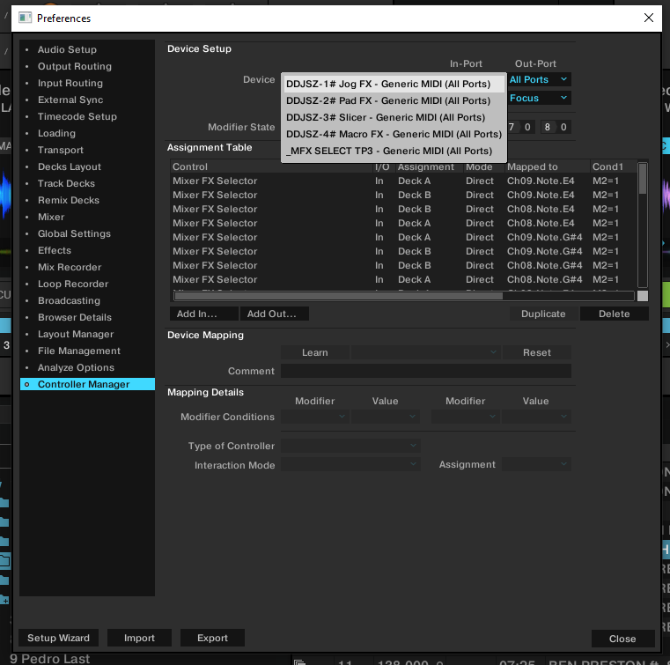
ANNEX: DDJ-1000SRT
(note: pictures are for v6.1.X; v6.7.0 will also work, but was not tested yet)

Slide 43
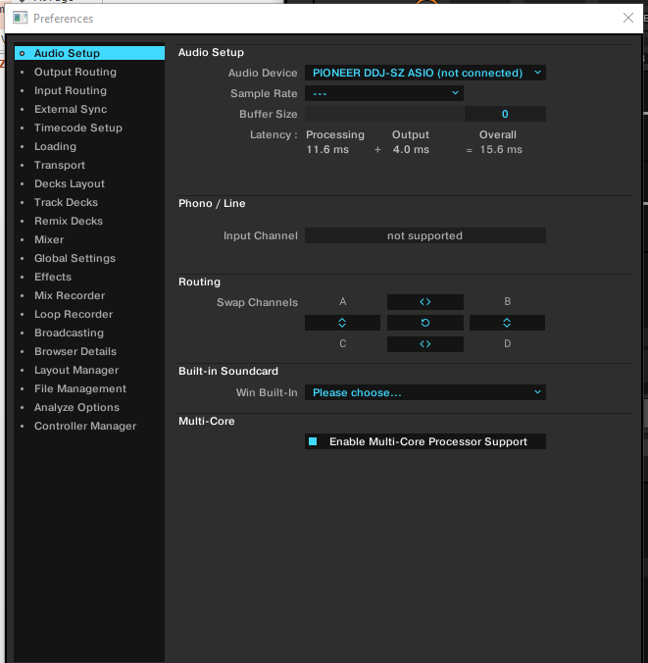
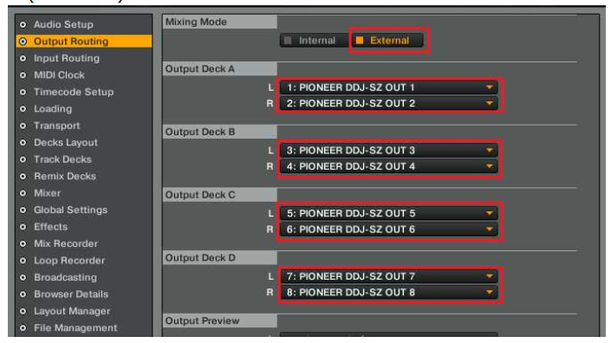
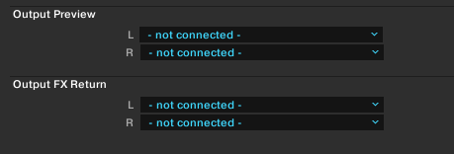
ANNEX: DDJ-SZ
SET PREVIEW TO
SAME VALUES
AS DECK 4!

Slide 44
ANNEX: DDJ-SX3
(Select SX3 device here)
(Select SX3 device here)
SET PREVIEW TO
SAME VALUES
AS DECK 4!

Slide 45
ANNEX: DDJ-SX2
(Select SX2 device here)
(Put SX2 channels here)

